Slide 1
The Society of women engineers

Slide 2
DEIB Moment

Slide 3
What’s Going On??? Winter Quarter
Officer nominations are open!
2/13 - Destress General Meeting
2/16 - ABB Lunch & Learn
2/16 - Destress Spa Night
2/20 - 2/24 - Good Luck on Finals!
Notes:
This is for up to week 6! (as far as I can tell)

Slide 4
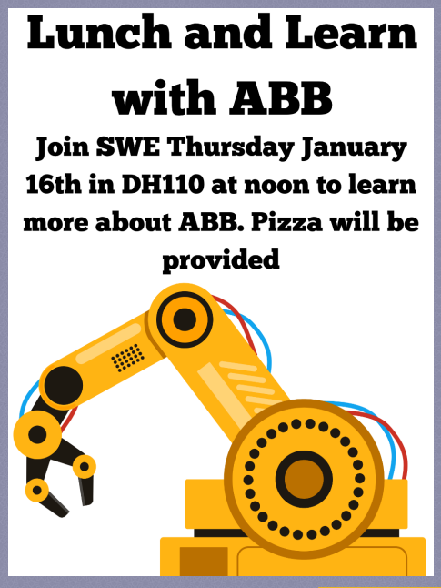
February

Slide 6
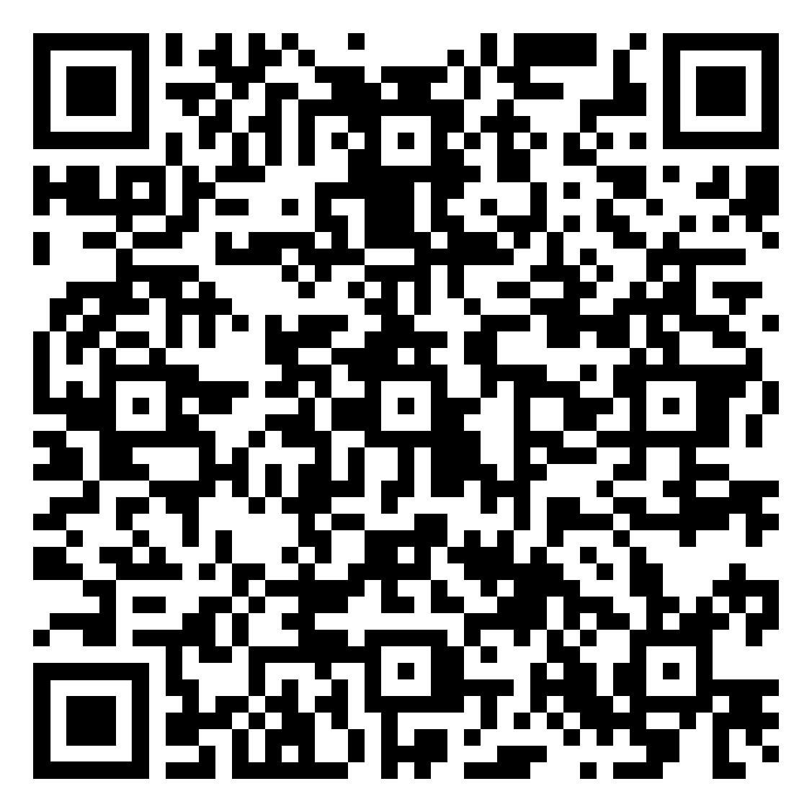
SWE Officer Roles
SWE has eight different officer roles and we’re having elections soon! Nominations are open and we’d love to answer any questions you have!

Slide 7
What’s Going On??? Spring Quarter
March - Elections! Must be a national member to vote Mr. MSOE Competition WELocal Seattle Conference
April - SWE-WI Conference Milwaukee Area Conference Girl Scouts Careers Day

Slide 8
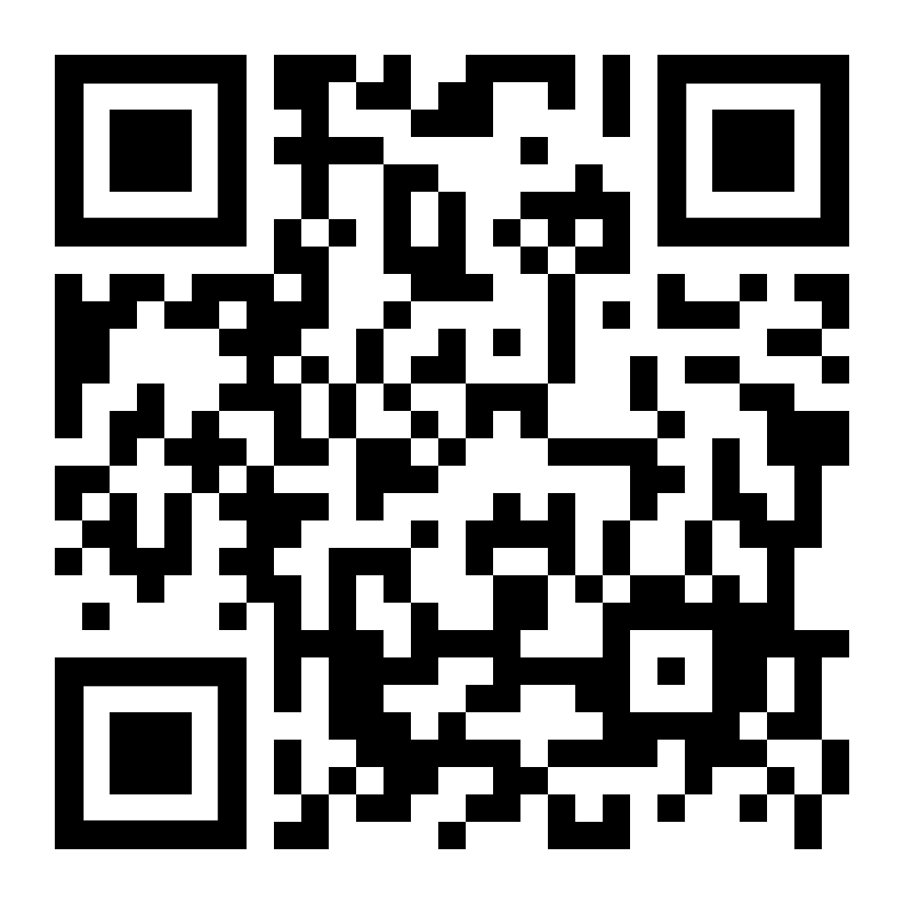
SWE Committees
If you are interested in helping with social, volunteer, & professional events, please register & we’ll contact you with more info on when meetings are!
You get 3 entries for the raffle for every meeting you attend!

Slide 9
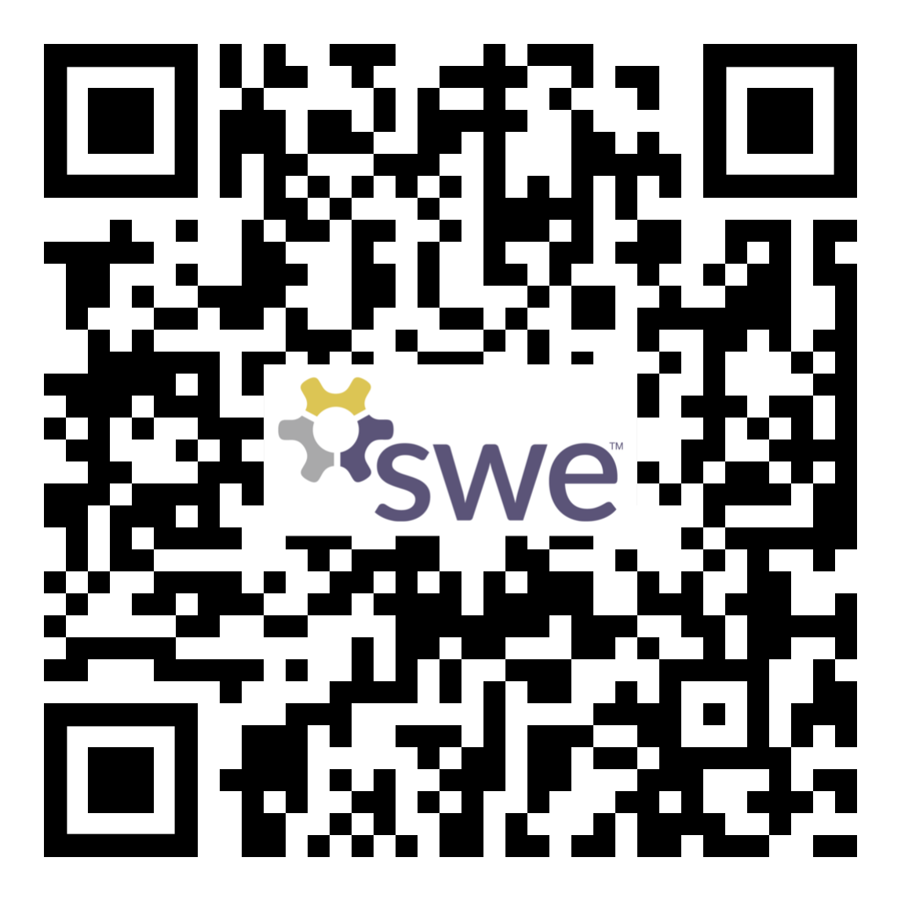
T-Shirt Contest Winner
Short Sleeve T-Shirt
Cost: $15
Pay with cash or venmo Marya!
Please mark the transaction as public with comment ‘swe shirt’
Order one here!

Slide 10
SWE-WI
Interested in attending a SWE Conference?
SWE-WI is a one day professional development conference and is taking place Saturday, April 15th in Madison!
Registration is $25 and transportation will be provided!

Slide 11
Membership Reward System
Your name will be put in a raffle for each time you fulfill one of these tasks below

Slide 12
Winter Quarter SWESTERS!!!
Drum roll please. . .

Slide 13
Winter Quarter SWESTERS!!!
Congratulations to Dani K.& Alex B. for being our Winter Quarter SWEsters!
Thank you both for volunteering and attending events <3

Slide 14
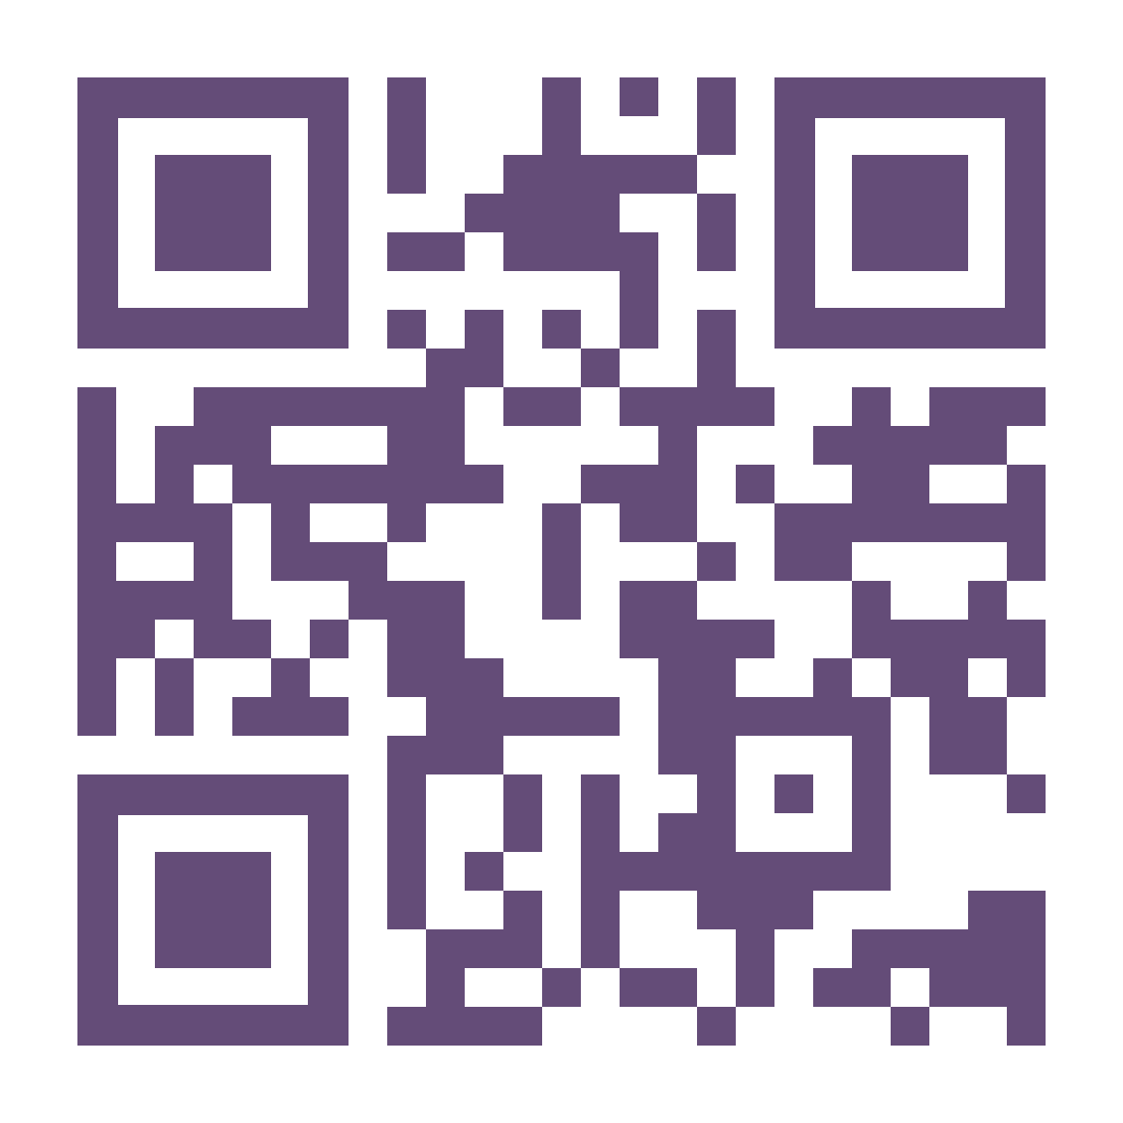
Follow Us On Social Media!
Link Tree QR

Slide 15
Today’s Meeting:
Design & Destress

Slide 16
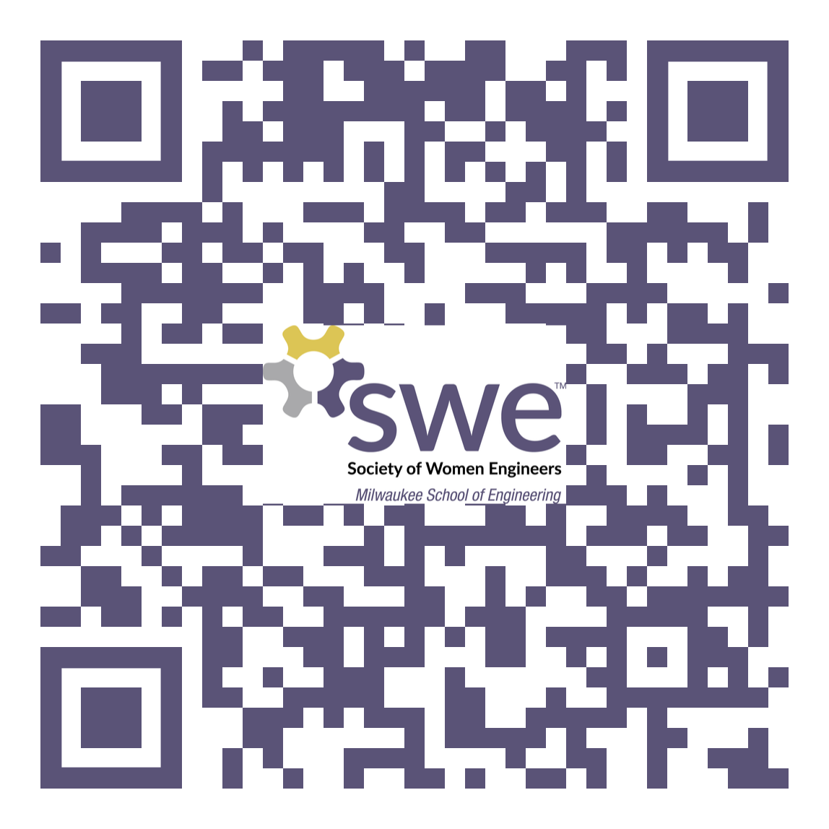
Please fill out this form for attendance!

